Slide 1
objective:-
Predict the Reliance Industries Stock Price for the next 1 Year.
There are Open, High, Low and Close prices that you need to obtain from the web for day starting from 2000 to 2022 for Reliance Industries stock.
Find short term, & long term trends.
Understand how it is impacted from external factors or any big external events.

Slide 2
Eda:-
Dataset contains 5755 observations and 7 variables.
Drop variables - Open, High, Low & Close.
Except Date datatype all variables datatype are correct.
10 nan values present in ‘Adj Close’ and ‘Volume’ and replaced them by median value.
No duplicates are present.
There is negative 32% correlation between independent variables.

Slide 3
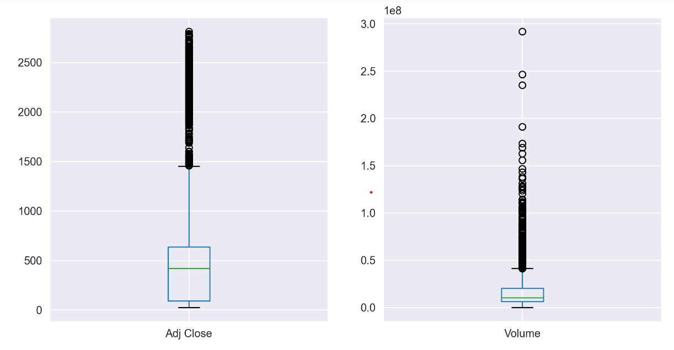
Outliers:-
Outliers present in ‘Adj Close’ and ‘Volume’.
Outliers present in ‘Adj Close’ = 704
Total percentage = 12.23%
Outliers present in ‘Volume’ = 470
Total percentage = 8.17%

Slide 4
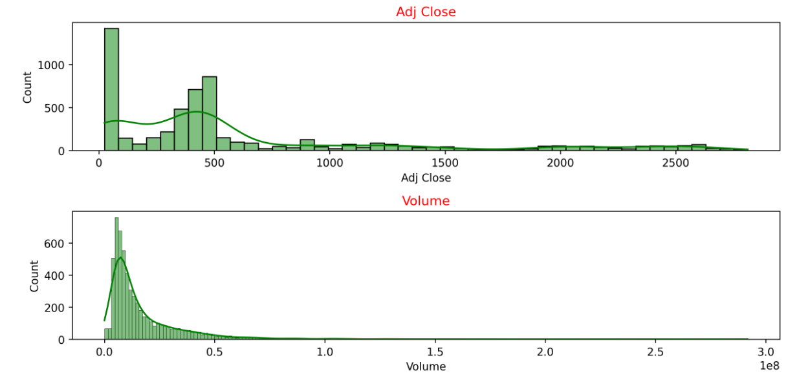
Data Distribution:-
Data distribution of ‘Adj Close’ and ‘Volume’.
In both the variables data is positively skewed.

Slide 5
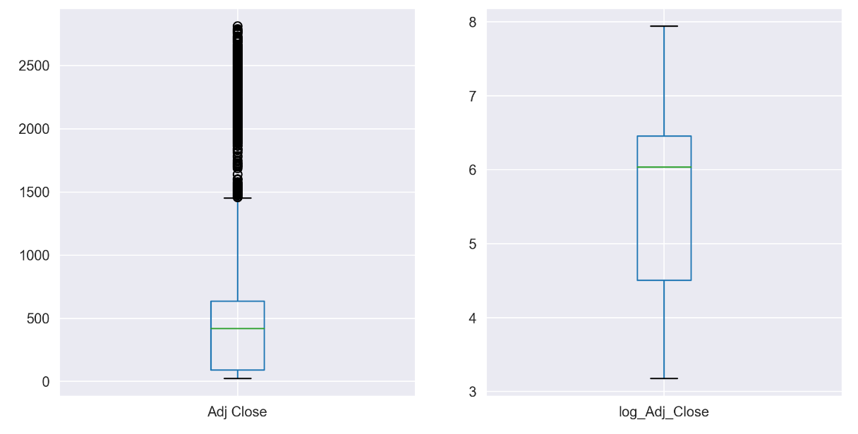
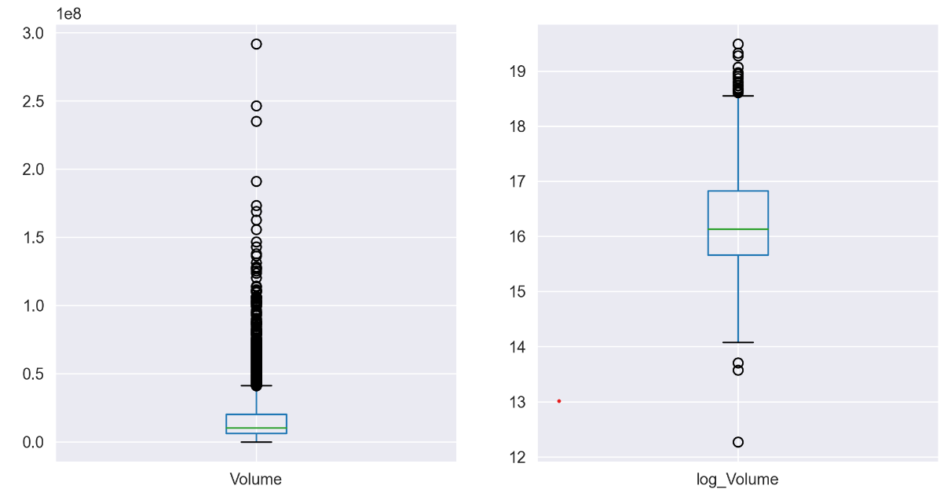
Outlier treatment:-
We applied log transformation on both the variables to remove the outliers and to get normal distribution.
Adj Close
Volume

Slide 6
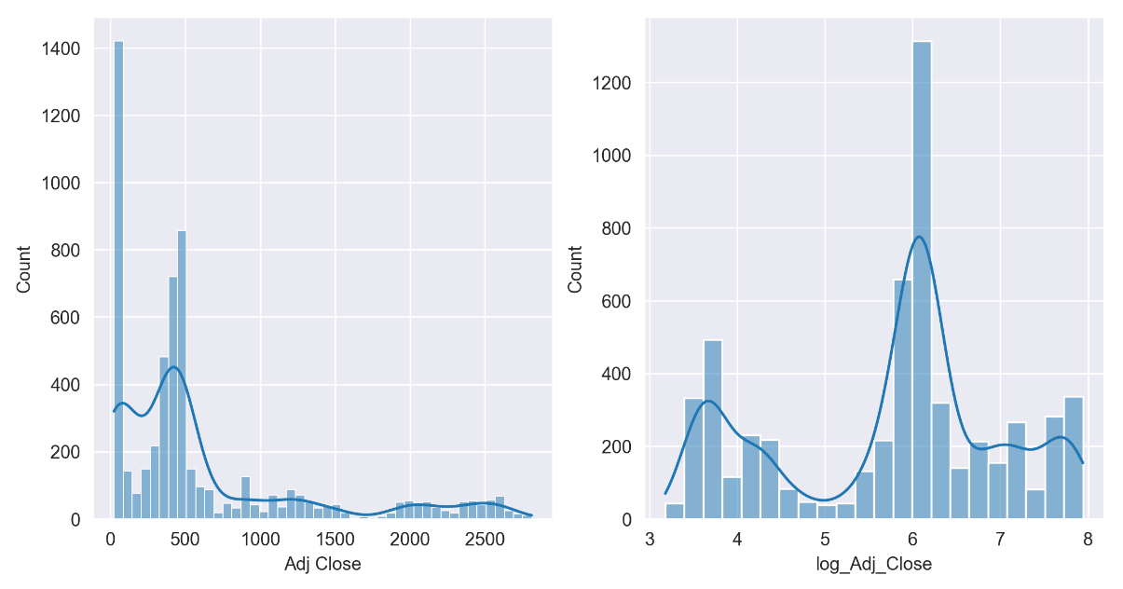
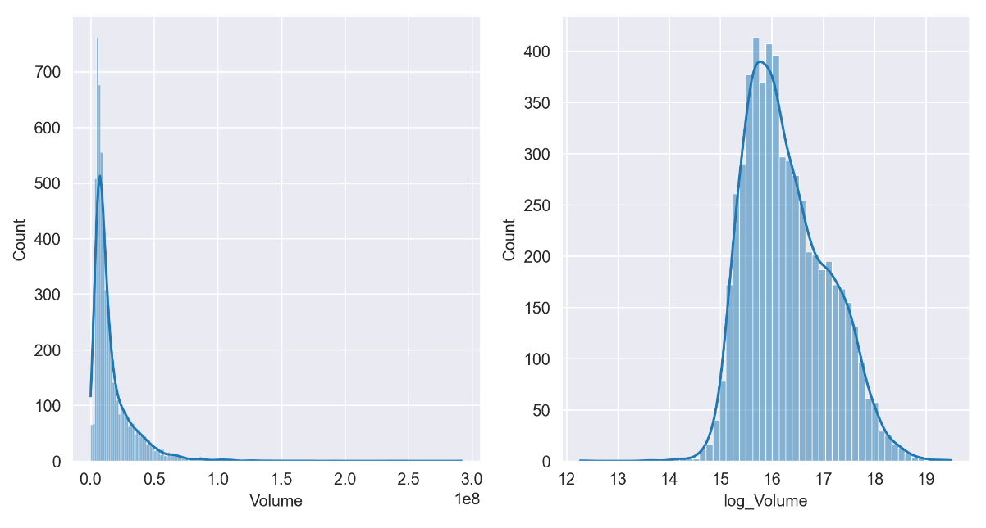
Outlier treatment:-
Data distribution after log transformation.
Adj Close
Volume

Slide 7
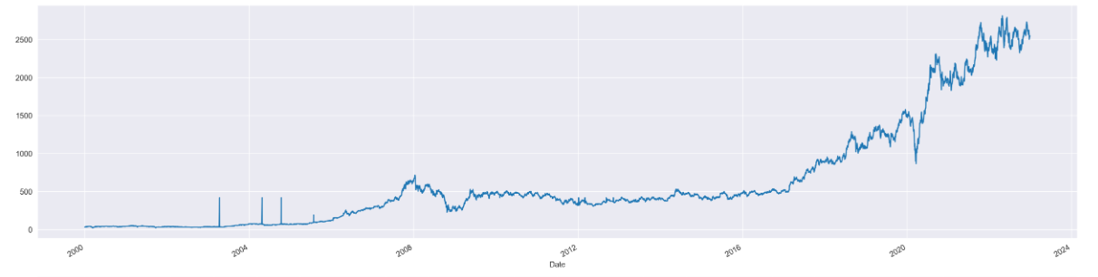
Trend and seasonality:-
We check Trend and Seasonality using line chart.
Adj Close
Trend is Exponential and their is no seasonality present in data.

Slide 8
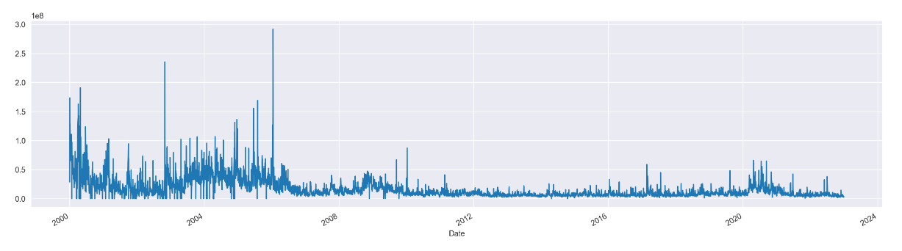
Trend and seasonality:-
We check Trend and Seasonality using line chart.
Volume
Constant trend and no seasonality present in data.

Slide 9
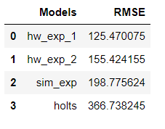
Model Building:-
I) Data Driven Methods.
1) Exponential Smoothing.
i) Simple Exponential Smoothing Method.
ii) Holts Method.
iii) Holt-Winters Method.
1) Holts winter exponential smoothing with additive seasonality and additive trend.
2) Holts winter exponential smoothing with multiplicative seasonality and additive trend.

Slide 10
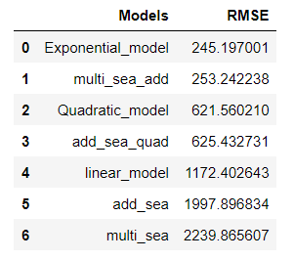
Model Building:-
II) Model Based Methods.
There are 7 model based methods we performed in this project as follows.
Linear Model
Exponential Model
Quadratic Model
Additive Seasonality
Additive Seasonality With Quadratic Trend
Multiplicative Seasonality
Multiplicative Seasonality With additive(linear) Trend
In Model based methods Exponential model gives lowest RMSE value.

Slide 11
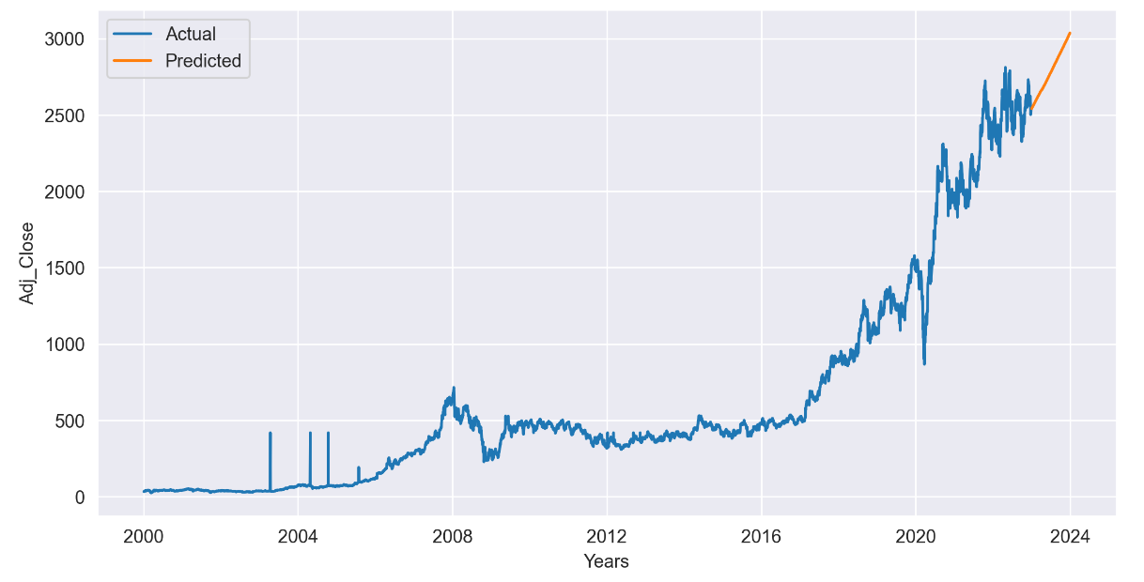
Final Model Building using exponential model and forecast:-
Forecast Reliance Industries Stock Price for next 1 Year.

Slide 12
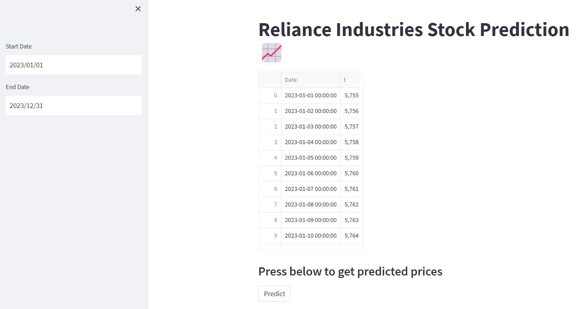
Deployment:-

Slide 13
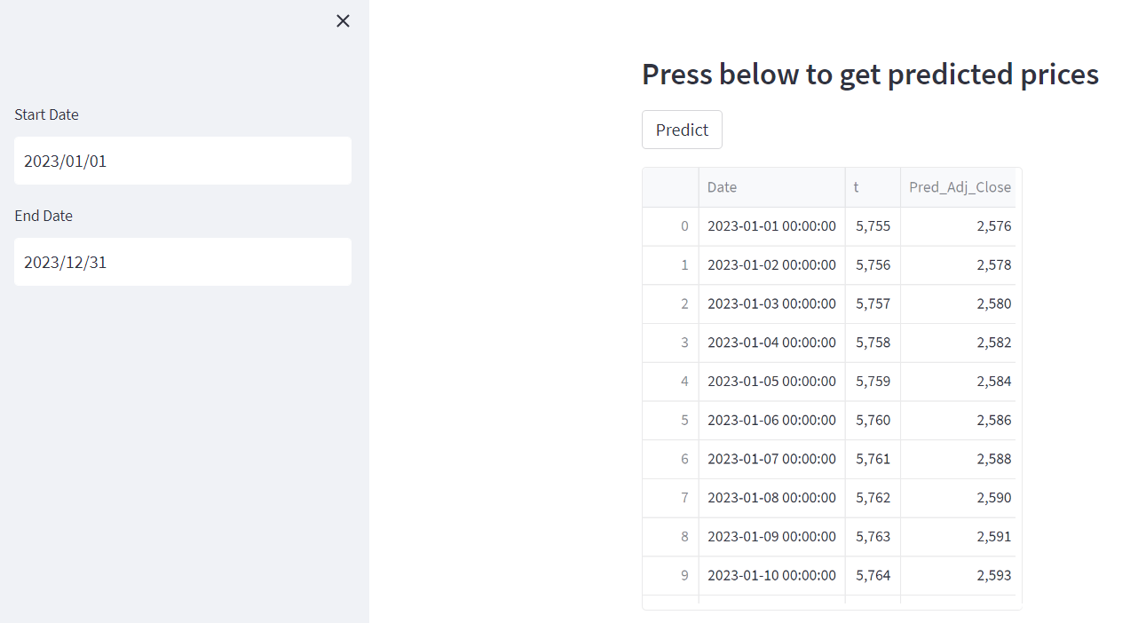
Deployment:-

Slide 14
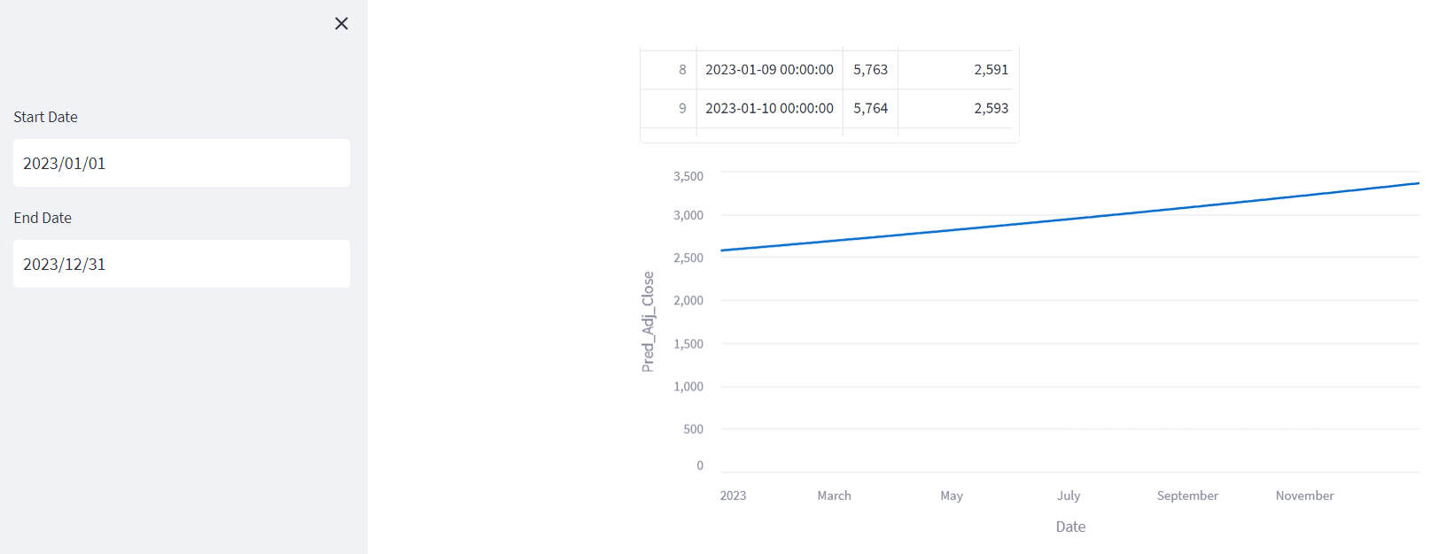
Deployment:-

Slide 15
Thank you

